Slide 1
TKG Care Delivery Overview

Slide 2
About The Kinetix Group (TKG)
DEEPLY INFORMED
TRUSTED TO DELIVER
We work directly with health systems, payers, and policy makers to develop and implement value-based care delivery.
Our full-service agency services span the entire lifecycle of product development and commercialization programs.
PEOPLE
PROCESS
PARTNERSHIPS
Deep understanding of market dynamics and the ability to translate trends into actionable strategies
Proprietary Insights in multiple therapeutic areas including women’s health, oncology and infectious disease
Practical, proactive, and real-world solutions informed by the integration of internal and external stakeholder insights
TKG provides end-to-end services, from business & organizational strategy through execution
Notes:
Voice Over:
TKG is deeply informed and trusted to deliver
Deeply informed because we work with a variety of stakeholders to understand their needs, build relationships, and design strategies to help them achieve quadruple aligned care (quality, cost, provider wellbeing, patient satisfaction)
Trusted to deliver because TKG’s agency side of the business focuses on the execution of informed strategy
When asked to describe what I do in one sentence, I often say: I work with health systems to build out a population health infrastructure to help them succeed in value-based care arrangements in the future, meaning we’re designing strategies to help them to improve outcomes and decrease costs for patients with chronic conditions.
To achieve this work, we need to understand market dynamics, generate insights, and build out partnerships to test out solutions in the real-world

Slide 3
TKG Insights and Expertise Support New Client Marketing Models
payer
TECHNOLOGY
Quality payment program strategy and design
Results: $41 million net savings in year one, sustained clinical quality improvement, improved provider satisfaction
government
Life sciences
Community paramedicine payer contracting strategy and value model
Results: Payer contract execution with 8 plans
CCM partnership implementation
Agency of Record – Market Access (Payer and Health Systems)
Strategic Partner – HCP Marketing
Government Affairs
RWE Generation and Demonstration Projects
Multi-Cultural Marketing - Consumer
Strategic Customer Engagement Partner
National practice transformation model strategy and implementation
Results: 4,500 providers engaged, quality measure improvement in 170,000 patients, $98 million cost savings
Network of Quality Improvement and Innovation Contractors (NQIIC) awardee
Oncology Care Model implementation partner
Health system
employer
V-BID implementation strategy
Results: Successful employer plan rollout
Health system population, health organization design, strategic program analysis, and financial impact model
Clinical program design for high-risk populations
Notes:
Work with a variety of stakeholders ranging from health systems to payers (commercial and public) to tech companies

Slide 4
TKG Networks of Excellence are a Powerful Vehicle for Market Development
Underrecognized disease state impacting a significant population
Deployment of key interventions and scaled adoption
Robust clinical pipeline and burgeoning market development opportunity
Preferred relationships with leading experts
Privileged disease state insight
Health system evidence generation & proof of concept
CONFIDENTIAL & PROPRIETARY – DO NOT DISTRIBUTE
Notes:
Thanks to Mindy, TKG’s care delivery business has become more organized over the past couple years

Slide 5
Network of Excellence/Workgroup Journey: Answer Fundamental Questions to Inform TKG’s Strategy & Enable K.I.S.S. Execution
7
What is the impact of Networks of Excellence and Workgroups on our business?
CENTERS OF EXCELLENCE
HOSPITAL SYSTEM EXECUTIVE BOARD
ONCOLOGY
CKD
BEHAVIORAL HEALTH
2018
2019
2020
2021
Impact and advance health care
and payment reformation
Represent significant
business opportunities
Drive innovation amongst
multiple stakeholders
Notes:
Networks formed over the past few years recognizing emerging needs
The Why:
When and how do we deliver value-engagement?
How do we optimize our products and services within a changing market?
How do we lead with forward-thinking programs and solutions?

Slide 6
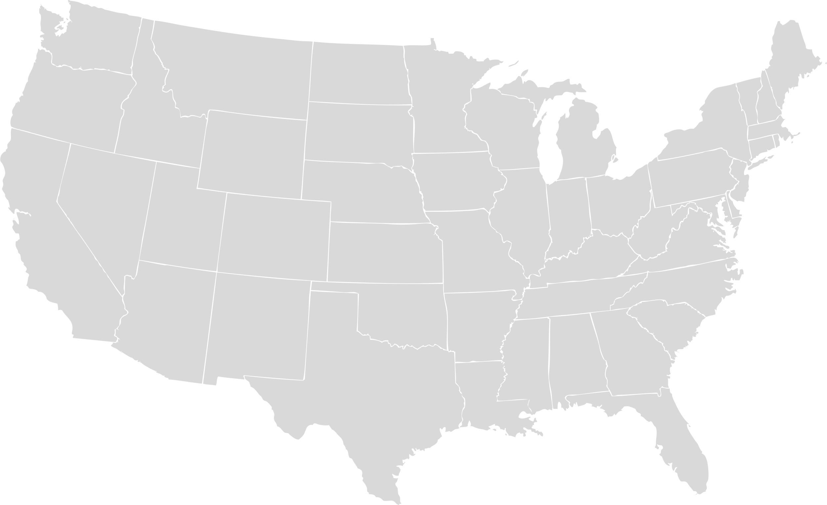
NOE’s Build a Framework Supporting Healthcare Transformation
NoE Charter
Generate revenue
Fulfill TKG Deeply Informed mission
Support Commercialization
REACHING
approximately
60M
PATIENTS
180k
PHYSICIANS
Updated 5/17/21
Pop Health Leaders Network
NASH NET
Women’s Health research Collaborative
Oncology
CKD
Behavioral Health
Senior/Health Aging

Slide 7
Networks of Excellence Garner Worldwide Best Practices
Mainz, Germany
Linkoping, Sweden
London, United Kingdom
Sevilla, Spain
Haifa, Israel
Dublin, Ireland
Perth, Australia
NASH NET
Women’s Health research Collaborative

Slide 8
Networks of Excellence Focus On the Key Pillars of Care Delivery
PATIENT IDENTIFICATION
RISK STRATIFICATION
REFERRAL TO SPECIALIST
ONGOING MANAGEMENT
Share best practices through publications and white papers
Provide thought leadership on payer and industry population health proposals
Provide expertise guidance, design, and testing for pilot programs
Assess and identify potential industry/health system collaborators for pilot programs

Slide 9
The Networks of Excellence Leverage Unparalleled Knowledge to Build a Framework Supporting Healthcare Transformation
Sharing & Insights
Research to Drive Adoption
Raises awareness of less prevalent conditions
Guideline development and establishes approach for RWE
RWE drives adoption, momentum
Accelerated identification of unmet health needs
Value creation
Engage Multi-Stakeholders
Define & disseminate
Best Practices
generate
Real world evidence
Connection to Purpose
Strengthens credibility
Promotes innovation
Continuous learning
Scale best practices/guidelines
Partner with advocacy organizations
Publications of partnerships
Expand to additional stakeholders
GENERATE insights
ACTIVATE
Networks of Excellence bring forward a proven methodology to ensure a successful partnerships and translate value across the healthcare landscape
CONFIDENTIAL. DO NOT DISTRIBUTE.
Notes:
Real-time access to every customer voice with over 350 KOL’s including C-suite and D-suite influencers that covers key decisions makers across the nation
Leverages unparalleled knowledge with access to and insight from multi-stakeholder decision makers to define and optimize healthcare transformation
Assessing unmet needs and understand impact
Promoting direct insights/access to key stakeholders to strengthen credibility
Sharing best practice by focusing on – our pillars of accelerating identification, appropriate assessment and referrals, optimal treatments and ongoing management
When EBG and protocols don’t exist, we work with mutli-stakeholders to Building Real World Evidence (RWE) as part of solution
That is shared, scaled broadly to rise all ships
IF SPEAKING TO PHARMA – SAY THIS BULLET AND CHANGE ACTIVATE TO COMMERCIALIZE Ability to commercialize additional solutions (Consider including in all NOE/WG/Products: MTM & Patient Navigation)

Slide 10
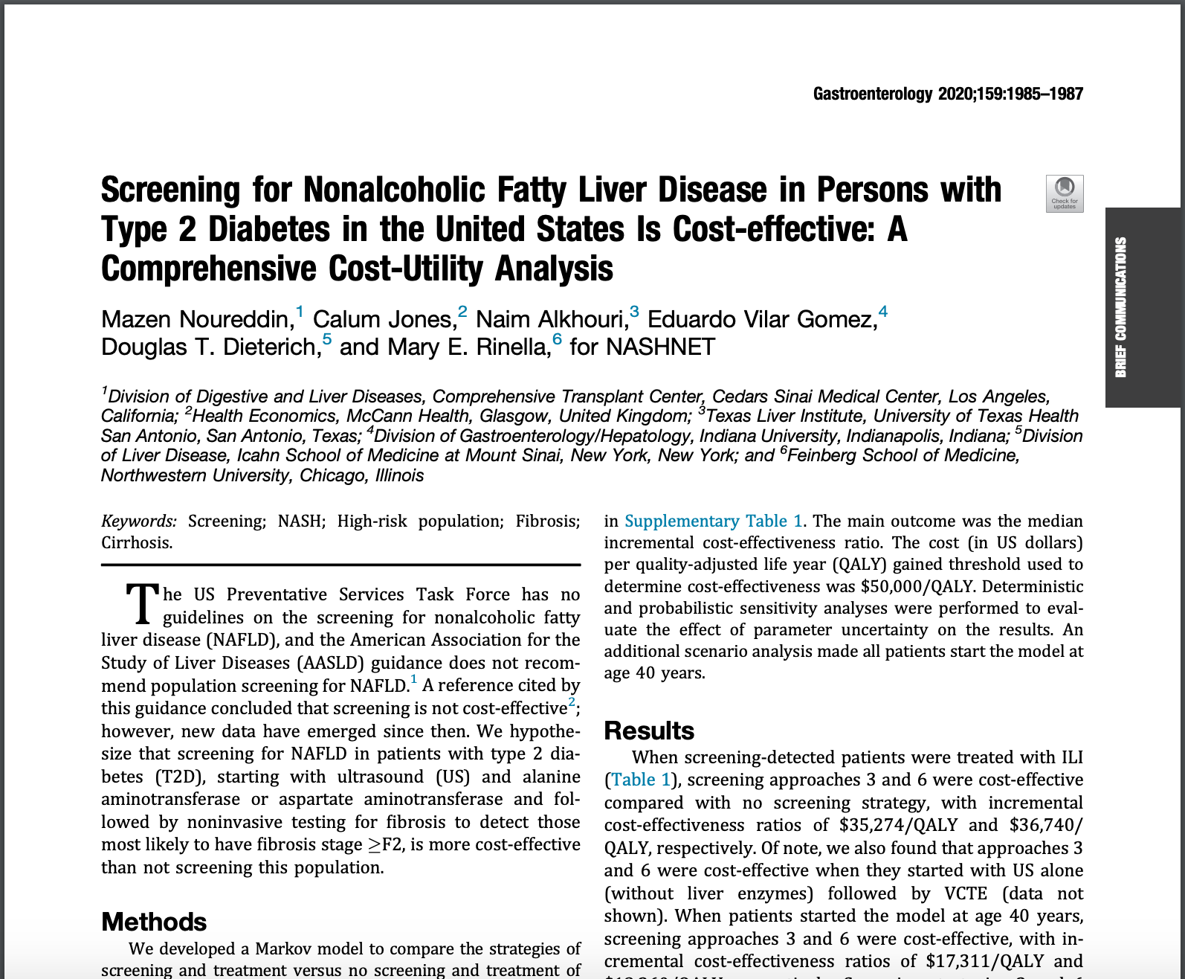
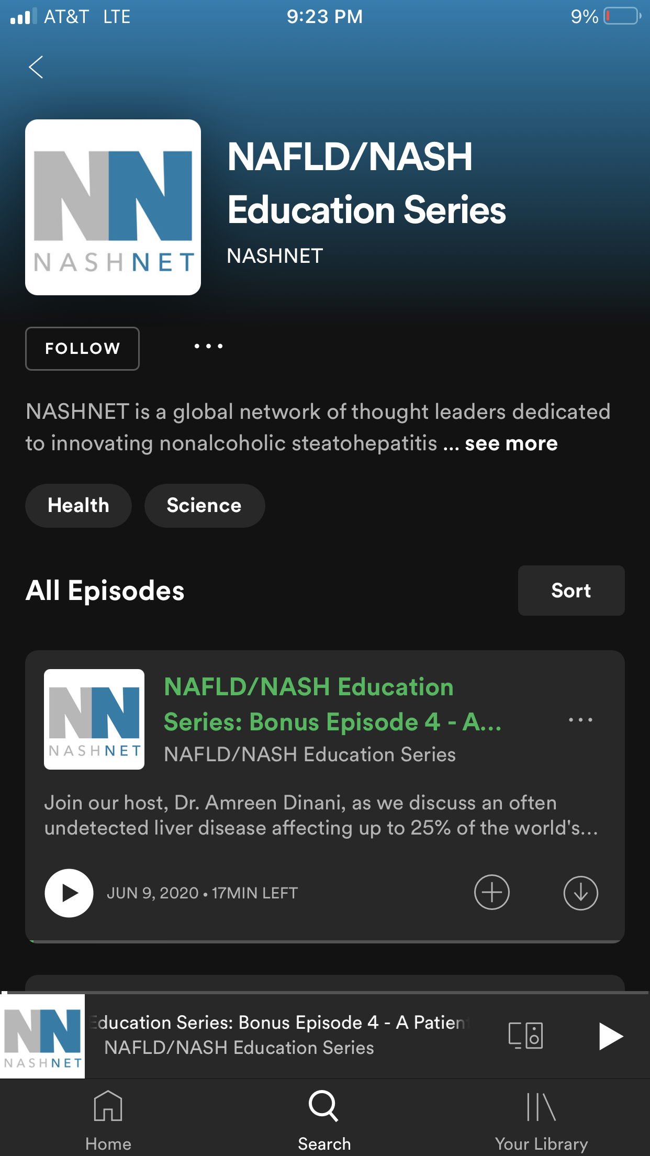
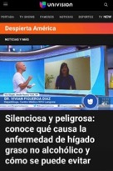
Examples of How Workgroups Produce Impactful Results and Best Practice Sharing
Payer Engagement
Provider awareness & Education
patient ADVOCACY & Education
RWE Generation & Publications
Payer Insights Network
Routine surveys
Coverage & placement
Prior authorization challenges
Multiple Industry-Funded RWE Initiatives
Heavy Menstrual Bleeding Publication (in progress)
Health System & Pharma Value-based Arrangement Compendium (in progress)
Cost Effectiveness Analysis Publication in GASTRO (below)
Provider Education Podcast Series
Advisor-led education
Burden of disease
Emerging treatments
The patient perspective
Patient Education Partnership with Univision
Spotlight disease prevalence with network advisor

Slide 11
Networks Overview
 | Business Line | Description | Teams Involved
NETWORKS | NASHNET | A global network of thought leaders dedicated to advancing care pathways for nonalcoholic fatty liver disease (NAFLD) and nonalcoholic steatohepatitis (NASH) | Co-Leads: Kristen Shea and Anna Thomas Support: Kristi Abbott
 | Population Health Leaders Network | Connects healthcare leaders to promote and accelerate adoption of innovative population health models | Lead: Amanda Peterson Support: Anna Thomas and Mindy Olivarez
 | Women’s Health Research Collaborative | WHrC is a multi-stakeholder led initiative to identify gaps in women’s health care and address unmet needs | Lead: Mindy Olivarez Support: Mac Munro
 | Hospital System Executive Board | Brings C-suite level executives together to garner insights, identify research topics and sharing of best practice recommendations | Lead: Warren Smedley Support: Andrea Youngstrom, Sara Pugh, JP Strapp and Neal Peyser
WORKGROUPS | Senior/Healthy Aging | Advancing healthy aging strategies to support physical, behavioral and well-being | Lead: Kristen Shea Support: Anna Thomas and Mindy Olivarez
 | Behavioral Health | Advancing behavioral health strategies to support integrated, whole-person health and optimal outcomes for those with BH and SUD disorders | Lead: Mindy Olivarez Support: Merissa Oliver, Anna Thomas
 | Oncology | Workgroup formed to leverage strategies, partnerships, and tools that align cancer care to the Quadruple Aim: improve the patient care experience, improve the health of a population, improve clinical experience, and reduce per capita health care costs | Lead: Warren Smedley Support: Andrea Youngstrom, Sara Pugh and JP Strapp
 | Chronic Kidney Disease | Network of healthcare organizations committed to CKD care delivery innovation, striving to develop novel scalable solutions to improve education, patient identification and stratification, and service line management | Co-Leads: Kristen Shea and Anna Thomas Support: Kristi

Slide 12
Networks of Excellence Produce Scalable Platforms and Tactics Aligned to the Quadruple Aim
Patient Advocacy & Education
Sharing resources in a language and reading level to help patients understand their disease and how it may progress
Provider Awareness & Education
Sharing best practices and educating front-line on disease states that are affecting downstream resource utilization – through podcasts
Improving
Patient
Experience
Improving Population
Health
RWE Generation
Physicians can generate data based on their original ideas with analytic and project management support
Payer Engagement
Reduce hurdles for patients to receive care by optimizing care processes
Quadruple Aim
Payer Engagement
Coverage considerations for new diagnostics and therapeutics to identify patients earlier in disease progression
Provider Awareness & Education
Creating more awareness of disease states beyond it’s typical specialty care setting
Reducing Costs
Improving Provider Satisfaction
RWE Generation
Developing cost effectiveness analysis studies in the US and EU to determine cost-effective pathway
Payer Engagement
Providing clinicians with more diagnostic options for patient identification/risk-stratification

