Slide 1
Kinetix University Overview
2022

Slide 2
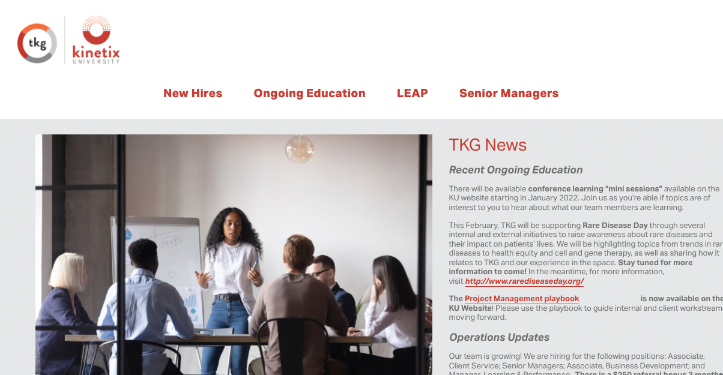
Continuous learning platform for The Kinetix Group
New Hire Onboarding
Senior Manager Leadership Program
LEAP
Program
Ongoing
Education
Skills Development
Industry Insight
Engagement Formats
SME-led
Sessions
Peer-to-Peer Sessions
Self-Study Resources
Additional Employee Engagement Venues
Engagement Platforms
KU Website
Staff Meetings
TKG Days
Business updates, announcements, and high-level info sharing
Company-wide learning and best practice sharing intended to connect and motivate

Slide 3
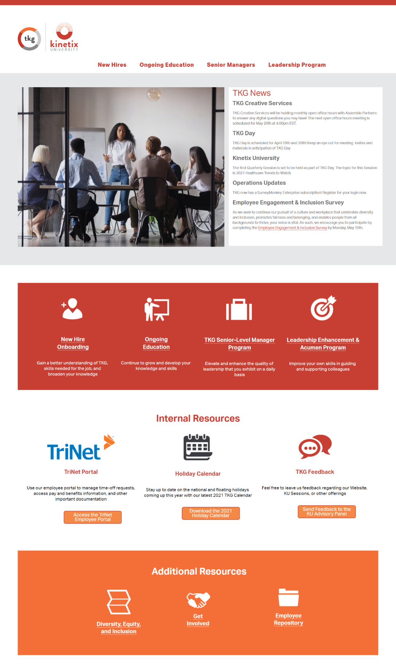
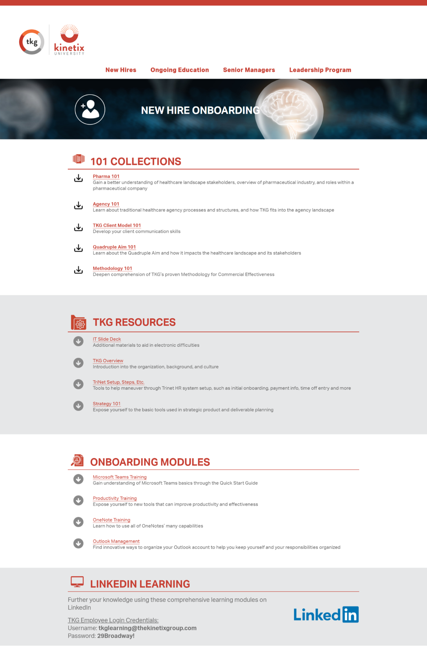
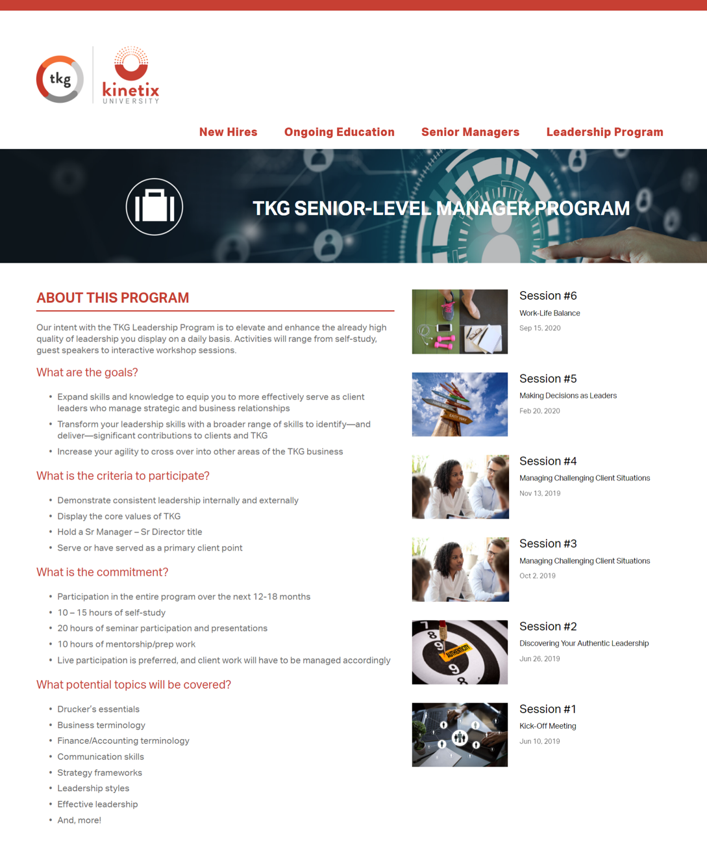
Website Highlights

Slide 4
LinkedIn Learning

Slide 5
KU Ongoing Education Overview
Core Areas:
Pharma Updates/Trends
Agency Updates/Trends
Market Access
Healthcare Delivery
Other Miscellaneous, Self-Guided Resources based on Special Interests
Book Club
Previous titles include:
“When Breath Becomes Air” by Paul Kalanithi
“Just Medicine: A Cure for Racial Inequality in American Healthcare” by Dayna Bowen Matthew
“Always Looking Up: The Adventures of an Incurable Optimist” by Michael J. Fox

Slide 6
Overview of Recent and Upcoming Sessions
Healthcare Disruptors:
Improving Access to Care
Wed, May 25th 12-1pm ET
Market Access: Building a Strategy for Successful Launch
Mid-summer (Date to be announced)
Pharma 201: Understanding Customer Management Teams
Guest facilitators:
Dr. Eric Newman, Former Director of Quality and Innovation at Geisinger
Joe Brennan, Director of Provider Solutions at TytoCare
Guest facilitator: Dr. Daniel Tomaszewski, PharmD, PhD, Associate Professor of Pharmaceutical and Health Economics at USC
Focus on understanding typical team profiles, trends from industry leaders, and environmental factors that influence organization structure and teams
Late summer/early fall

Slide 7
Latest Book Club Edition
2-3 sessions/books per year
Range of topics/titles from healthcare industry-related to other special interests
TKG group poll on title selection and company reimbursement for title purchase

