Slide 1


Pharma 101 Expansion
Product 2.0
August 17, 2021

Slide 2
SESSION OVERVIEW
1
Product Lifecycle
  Overview
  Early Phase
  Middle Phase
  Value chains in pricing
2
Product Trends
  Rising drug costs
  COVID-19 Impact
  Data trends

Slide 3
BUILDING ON PHARMA 101
PHARMA 101: KEY COMPONENTS
PHARMA 201: KEY COMPONENTS
Introduction
Healthcare Landscape stakeholders
Overview of Pharmaceutical Industry
Product Lifecycle
(today)
Product Categories
Pharma Operating Model
Roles and Responsibilities Within a Pharma Company
Customer Management Deep Dive: Sales, Marketing, Account Management (coming soon)
Evidence Generation
Connected Delivery
Customer Management
Overview of Pharmaceutical Industry
Pharma Marketing:
Tactical Execution
(coming soon)
Target Audience
Branding
Tactical Examples

Slide 4
PRODUCT LIFECYCLE

Slide 5
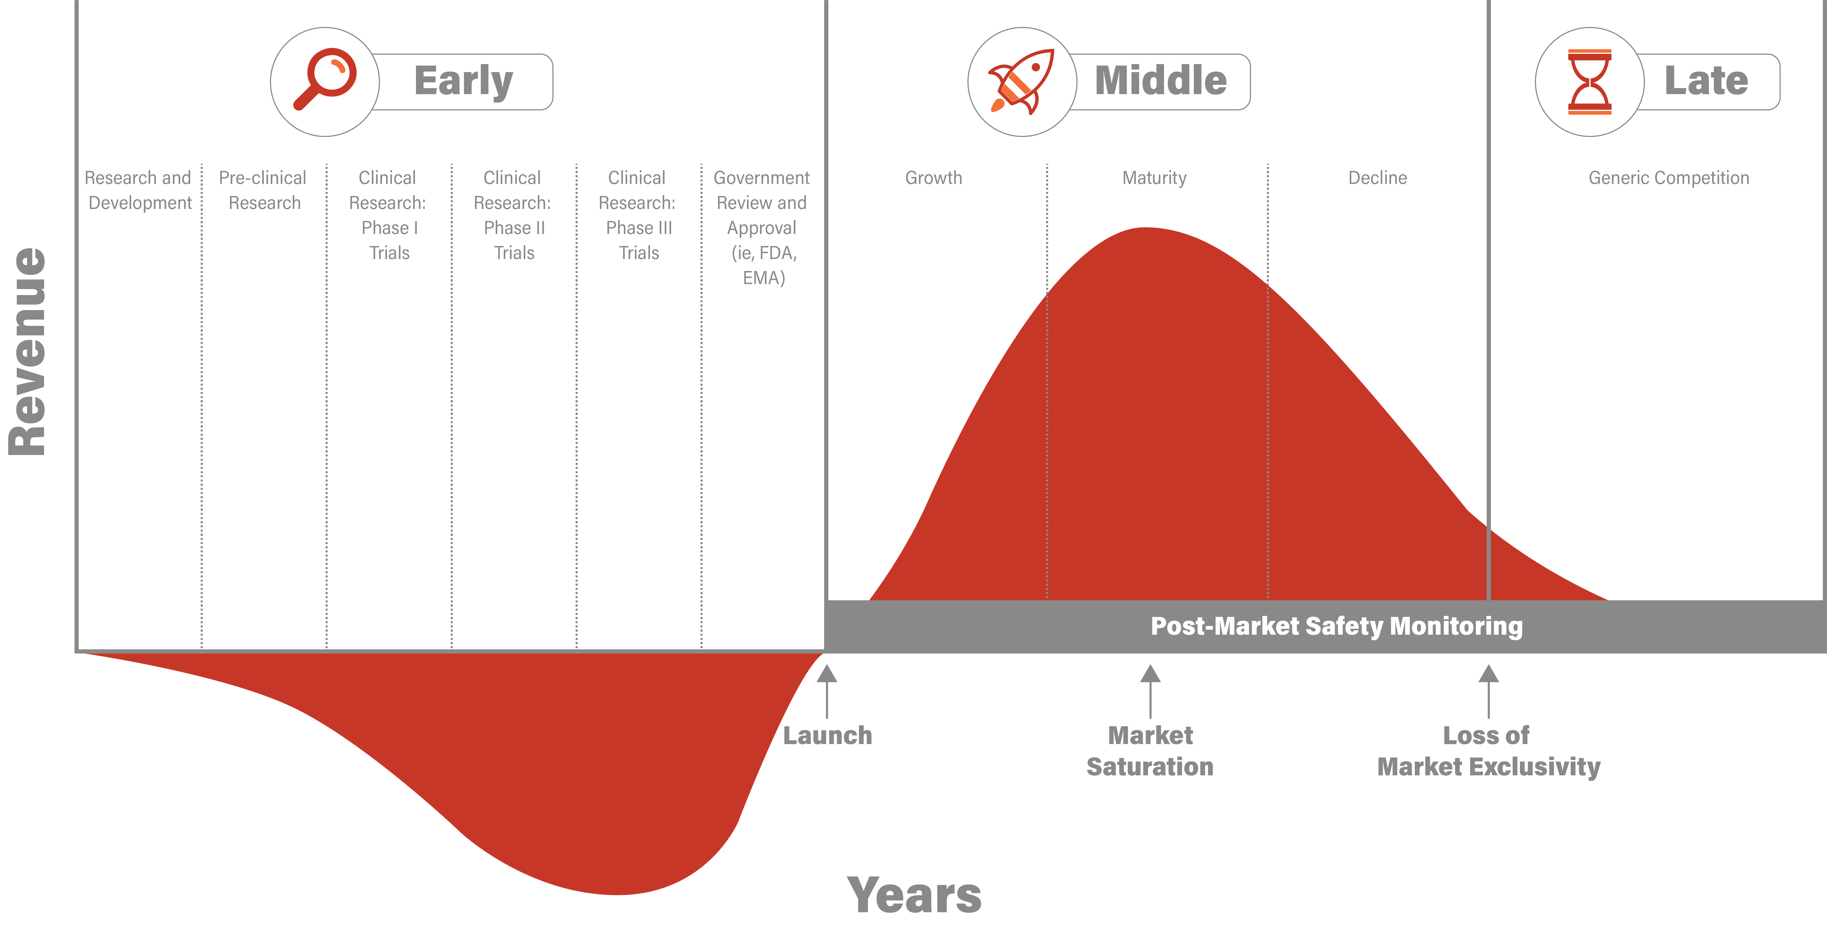
PRODUCT LIFECYCLE OVERVIEW

Slide 6
EARLY PHASE

Slide 7

EARLY: RESEARCH AND DEVELOPMENT + PRE-CLINICAL RESEARCH
Research and Development
Laboratory research aiming to discover and research promising compounds
    Serendipity (historical, observed effects of a treatment)
    New insights (disease process)
    Compound library screenings
Pre-clinical Research
Laboratory (in vitro) and animal testing (in vivo) to answer basic safety questions
“Blue sky” research often funded by academia, with later stage funding by venture capital, pharma, etc.
Have you encountered aspects of the Research and Development phase in your day-to-day work?

Slide 8
EARLY: CLINICAL RESEARCH
PHASE I
PHASE II
PHASE III
Study Participants: 20 to 100 healthy volunteers or people with the disease/condition.
Length of Study: Several months
Purpose: Safety and dosage
Study Participants: Up to several hundred people with the disease/condition.
Length of Study: Several months to 2 years
Purpose:
  Efficacy and side effects
  Inform Phase III
Study Participants: 300-3000 people with the disease/condition
Length of Study: 1 to 4 years
Purpose:
  Efficacy, quality and adverse effects
      Conduct research to uncover the scientific basis underlying a drug’s mechanism of action
Approximately 70% of drugs move to the next phase
Approximately 33% of drugs move to the next phase
Approximately 25-30% of drugs move to the next phase
How does this process show up in our day-to-day work?

Slide 9

EARLY: GOVERNMENT REVIEW AND APPROVAL - FDA/CDER
FDA
Center for Biologics Evaluation & Research
Center for Devices & Radiological Health
Center for Drug Evaluation and Research
Center for Food Safety & Applied Nutrition
Center for Tobacco Products
Center for Veterinary Medicine
Oncology Center of Excellence
Office of Regulatory Affairs
Center for Drug Evaluation and Research (CDER) Responsibilities
  Evaluate new drugs before they can be sold
  Provide information to doctors and patients to use drugs
  Ensure health benefits outweigh known health risks
HEALTH BENEFITS
HEALTH RISKS

Slide 10
EARLY: GOVERNMENT REVIEW AND APPROVAL – FDA/CDER
Investigational New Drug Application (IND)
  Sponsor submits to FDA and a local institutional review board (IRB)
PRE-NDA Meeting
New Drug Application (NDA)
  60 days for FDA to file for review or refuse (i.e., for incomplete data)
2
4
PDUFA Date
Approval or CRL received from FDA
6
1
Prescription Drug User Fee Act (PDUFA) Date Set
  PDUFA date determines when the FDA aims to review and respond to the NDA
Animal testing & clinical trial design
Clinical trials
  60 days for FDA to file for review or refuse (i.e., for incomplete data)
5
3
The FDA collects fees from drug manufacturers to fund the drug approval process

Slide 11
EARLY: GOVERNMENT REVIEW AND APPROVAL / Drug Development Designations
FAST TRACK
BREAKTHROUGH THERAPY
PRIORITY REVIEW
  Designed to develop and advance the review of drugs that treat serious conditions and fill an unmet medical need
Expedites development and review of drugs that treat serious conditions that show remarkable improvements over currently available treatments or therapies
  The FDA aims to act in 6 months as compared to 10 months

Slide 12
A DRUG DEVELOPMENT PROGRAM MAY QUALIFY FOR MORE THAN ONE EXPEDITED PROGRAM
 | Fast Track | Breakthrough Therapy | Priority Review | Accelerated Approval
Nature of Program | Designation | Designation | Designation | Approval Pathway
Qualifying Criteria | A drug that is intended to treat a serious condition AND nonclinical or clinical data demonstrate the potential to address unmet medical need OR A drug that has been designated as a qualified infectious disease product | A drug that is intended to treat a serious condition AND preliminary clinical evidence indicates that the drug may demonstrate substantial improvement on a clinically significant endpoint(s) over available therapies | An application (original or efficacy supplement) for a drug that treats a serious condition AND, if approved, would provide a Significant improvement in safety or effectiveness OR Any supplement that proposes a labeling change pursuant to a report on a pediatric study under 505A OR An application for a drug that has been designated as a qualified infectious disease product OR Any application or supplement for a drug submitted with a priority review voucher | A drug that treats a serious condition AND generally provides a meaningful advantage over available therapies AND demonstrates an effect on a surrogate endpoint that is reasonably likely to predict clinical benefit or on a clinical endpoint that can be measured earlier than irreversible morbidity or mortality (IMM) that is reasonably likely to predict an effect on IMM or other clinical benefit (i.e., an intermediate clinical endpoint)
When to submit request | With IND or after Ideally, no later than the pre-BLA or pre-NDA meeting | With IND or after Ideally, no later than the end-of-phase 2 meeting | With original BLA, NDA, or efficacy supplement | The sponsor should ordinarily discuss the possibility of accelerated approval with the review division during development, supporting, for example, the use of the planned endpoint as a basis for approval and discussing the confirmatory trials, which should usually be already underway at the time of approval

Slide 13
 | Fast Track | Breakthrough Therapy | Priority Review | Accelerated Approval
Timelines for FDA response | Within 60 calendar days of receipt of the request | Within 60 calendar days of receipt of the request | Within 60 calendar days of receipt of original BLA, NDA, or efficacy supplement | Not specified
Features | Actions to expedite development and review Rolling review | Intensive guidance on efficient drug development Organizational commitment Rolling review Other actions to expedite review | Shorter clock for review of marketing application (6 months compared with the 10-month standard review) | Approval based on an effect on a surrogate endpoint or an intermediate clinical endpoint that is reasonably likely to predict a drug’s clinical benefit
Additional Considerations | Designation may be rescinded if it no longer meets the qualifying criteria for fast track | Designation may be rescinded if it no longer meets the qualifying criteria for breakthrough therapy | Designation will be assigned at the time of original BLA, NDA, or efficacy supplement filing | Promotional materials Confirmatory trials to verify and describe the anticipated effect on IMM or other clinical benefit Subject to expedited withdrawal
Example: Palovarotene (an Ipsen product developed to treat an ultra-rare genetic disorder, fibrodysplasia ossificans progressiva (FOP) was granted Rare Pediatric Therapy, Breakthrough Therapy, and Priority Review designations
Example: A new, controversial Alzheimer's drug, Aduhelm, was recently approved using the accelerated approval pathway, which can be used for a drug for a serious or life-threatening illness that provides a meaningful therapeutic advantage over existing treatments. Accelerated approval can be based on the drug’s effect on a surrogate endpoint that is reasonably likely to predict a clinical benefit to patients, with a required post-approval trial to verify that the drug provides the expected clinical benefit. It is not uncommon for drugs approved under this pathway to be removed from the market based on further data.

Slide 14
PRIORITY REVIEW VOUCHERS REPRESENT A HIGH FINANCIAL VALUE TO MANUFACTURERS
The US Congress created the priority review voucher program in 2007 based on a 2006 Health Affairs paper (Ridley et al. 2006).
The voucher program is intended to reduce two types of inefficiency:
The voucher program motivates more treatments for neglected diseases, rare pediatric diseases, and medical countermeasures
The voucher program speeds approval of potential blockbuster therapies in the US, getting US patients access to these treatments more quickly
Neglected Disease:
Ex: Tropical Disease such as Zika Virus
1 Priority Review Voucher
= 2 Priority Reviews
Two drugs receive priority review for each voucher: the drug winning a voucher for a neglected or rare pediatric disease, and the drug using a voucher for another indication.
The voucher entitles the bearer to regulatory review in about six months rather than the standard ten months.
Priority review vouchers do not expire
Rare Pediatric Disease:
Ex: Treatment for Duchenne muscular dystrophy (DMD)
Medical Countermeasure:
Ex: Treatment for Smallpox approved in 2018 and vaccine in 2018 (Smallpox and Monkeypox) due to concerns that disease could be used as biological weapons

Slide 15
PRIORITY REVIEW VOUCHERS CAN BE SOLD AT A HIGH PRICE
The voucher may be sold.
  For example, a small company might win a voucher for developing a drug for a neglected disease and sell the voucher to a large company for use on a commercial disease.
To provide FDA with more resources and mitigate this cost, the voucher holder must pay the FDA an additional user fee ($2,116,167 in fiscal year 2020).
Recent sales of PRVs have ranged from $80-$110M, however sales as high as $350M have been reported
The voucher’s value derives from three factors: shifting sales earlier, longer effective patent life due to earlier entry, and competitive benefits from earlier entry relative to competitors.

Slide 16
MIDDLE PHASE

Slide 17
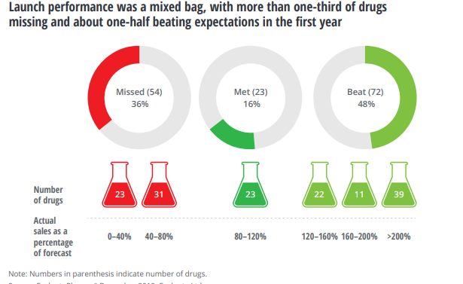
MIDDLE: LAUNCH
  Market shaping
  Market access
  Education
  Advocacy
What have you experienced as part of launch activities?

Slide 18
MIDDLE: POST MARKET MONITORING
Post-Market Safety Monitoring
  Drug safety is continuously monitored once It is available for use by the public
Real world evidence
  Driven by the need for data beyond safety and efficacy ,i.e., real world performance, broader populations, QoL, cost, data
Traditional Randomized Clinical Trial (RCT) model
Fully integrated RCT/RWE model
As soon as trials are complete | In three to five years
Entire clinical development in controlled test environment with RCTs as main source of evidence post-PoC | Robust PoC based or experimental and real-world evidence; early launch to generate evidence rapidly on real world effectiveness
Safety; clinical efficacy | Safety; clinical efficacy until PoC real world effectiveness post-PoC; pay-for performance business model
Late launch; significant late development stage attrition; often low reimbursement level despite successful launch | Potential early commercial failure and liability risk; loss of reputation based on early launch or need for product withdraw; row reimbursement level at launch; need for longitudinal positioning to continuously increase reimbursement level
TIMING
EMPHASIS
FOCUS
CHALLENGES

Slide 19
MIDDLE: PHARMACEUTICAL VALUE CHAINS
Funds Flow
Pharmaceutical Manufacturer
Products Flow
WAC
Wholesaler
Rebates and fees
Payer/plan
Admin fees
Plan sponsor/
employer
AWP
Reimbursement less co-pay (from patient)
Rebate pass-through
PBM
Pharmacy
Provider
Prescription
Co-Pay
Patient

Slide 20
LATE PHASE

Slide 21
MIDDLE TO LATE PHASE
Patent system and lifecycle
    Patents are protected for a period of 20 years from time of filing
    Generics and biologics of the same product cannot be sold during this market exclusivity
Saturated market of products
  A saturated market is when the product has been maximized
  Saturated markets occur in the pharmaceutical industry when there are too many products with similar levels of efficacy and effectiveness in the same therapeutic class
Criticism under consideration
  Pay-for-delay with branded and generic products
    When drug companies agree not to compete

Slide 22
PRODUCT TRENDS

Slide 23
RISING DRUGS COSTS
Rising Drug Spend
Specialty Drugs
Because these drugs are so rarely used, they are often subjected to step therapy, prior authorization, and other access-limiting mechanisms
Because specialty drugs treat rare or life-threatening illnesses, pharmaceutical manufacturers can charge a premium
“When people ask me what keeps me up at night, I say specialty drugs”
Phil Oravetz, Chief Population Health Officer of Ochsner Health

Slide 24
COVID IMPACT – REGULATORY TRENDS
Funding, safety monitoring, emergency use authorization
QUICKER PATH TO MARKET
Engagement of FDA for guidance and expectations
EARLY-TO-MARKET OPPORTUNITY

Slide 25

DATA TRENDS
Real-time post-approval monitoring (RWE) is more significant than controlled clinical studies environments
Advanced real-world-evidence analytics can play an important role across the pharma value chain
R&D
Market Access
Sales & Marketing
Medical
Identify unmet need
Innovate in trial design
Improve trial design
Accelerate time to market
Refine formularies
Monitor real-world outcomes
Improve evidence of economical value
Improve formulary position
Achieve label expansion
Improve targeting of commercial activities
Refine commercial strategy
Build clinical-decision support systems
Improve pharmacovigilance
Strengthen evidence for differentiation
Improve effectiveness of medical affairs
Improve Adherence
Desire to accelerate R&D
Epidemiological Expertise
COVID 19 WAS A REAL CATALYST
Supporting Pricing and demonstrate value
Health Authorities methodology guidelines

Slide 26
DATA TRENDS
Revitalizing pharmaceutical research and development
  Reducing cycle times and lower late-stage attrition
    Currently, the average investment required to bring a new molecule to the market remains at $3 billion to $5 billion, and there is an unsustainably high late-stage attrition rate
    By reducing cycle times and lower late-stage attrition, profit can be retained, and research and development efforts will be more feasible
  Risk-based resource allocation to monitoring of clinical trial sites
    Prioritizing resources to develop treatments that have lower risks associated with funding

Slide 27
RAPID INNOVATION IN INDUSTRY
Curative therapies
  Novel treatments that cure, rather than treat, disease could reduce the demand for prescriptions
Customized treatments
  Personalized approaches to patients
  Design therapies tailored to a specific person
Digital therapies
  Digital interventions that track behavior, such as adherence to medicine or healthy eating
Prevention and early detection
  Overall emphasis on prevention rather than treatment could eliminate the demand for prescriptions
Nonpharmacological interventions
  Precision interventions using robotics, nanotechnology, tissue engineering etc.

Slide 28
THANK YOU & NEXT STEPS

