Slide 6
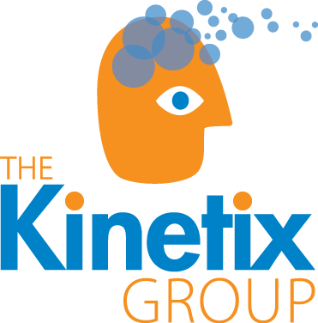

Slide 12
DUBLIN
Quality Impact Practice Transformation Network

Slide 14
Care Delivery & Health Systems Expertise
Proven Customer Engagement Strategy
Insights from our consultancy empower pharmaceutical companies to effectively engage stakeholders with proven, tested solutions

